Slide 1
Induction
For students who arrived week 1+

Slide 2
Content
Who’s who?
Induction activities
Attendance & engagement
Assessment & Academic Misconduct
Reporting an absence
General housekeeping
Internships
Getting support & help

Slide 3
Who’s who?
Module Leader
Looks after module-related queries (e.g. academic, assessment-related etc.)
Course Leader
Looks after course-related queries (e.g. wanting to change course, getting approval for certain processes). You can view the name of your Course Leader on our intranet: https://unity3.tees.ac.uk/Schools/scma/Pages/Academic-Support.aspx
Personal Tutor
Considers your attendance and engagement and can help with general queries. They will expect to meet with you during the year.

Slide 4
Induction Activities
Blackboard Course Support module
Ensure you have visited the module and viewed your course handbook
View the SCEDT Induction Information Hub
Welcome (tees.ac.uk)

Slide 5
Attendance and engagement
Your attendance and engagement is recorded on StReam (engage.tees.ac.uk)
For timetabled classes you must ensure you enter the correct attendance code to record your attendance at each teaching session.
Engagement is picked up from use of University systems etc.
Your Personal Tutor will talk to you about this
If you are a Tier IV visa student there is a legal requirement for us to monitor and report your attendance

Slide 6
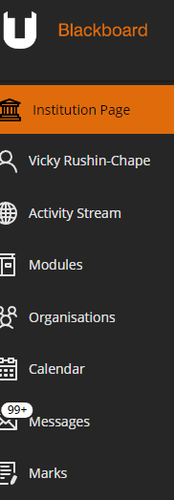
Assessment and Academic Misconduct
We take suspected Academic Misconduct seriously
Plagiarism (copying without proper referencing)
Collusion (sharing assessment content in individual pieces of work)
We use Turnitin submissions to check work for a % match
Use the draft Turnitin submission checker on Blackboard before submitting (Organisations)
Read assessment specifications very carefully and ask if there is anything you don’t understand

Slide 7
Reporting an absence
Before 10am on each day of your absence:
Report online via UNIverse or
Telephone 01642 342631

Slide 8
General Housekeeping
For TUSC card issues visit the Student Life Building (SLB)
For IT related issues contact ITHelp@tees.ac.uk or go to SLB
Check your University emails every day
Keep backups of your work
Read your course handbook (Blackboard Course Support module)
Take time to find out who your Course Leader is
Tell us if you are having any problems

Slide 9
Internships
If you are a 2-year Masters student you will complete the Advanced Practice internship at the start of your 2nd year
The internship will last 12 weeks (during one semester)
You can look for your own but it must be suitable (we check)
If you don’t find your own we will allocate you to an internship
You must tell us if you find your own
There are strict deadlines
The Placements team will lead briefings prior to your internship: placements@tees.ac.uk

Slide 10
Getting Support and Help
See your Module Leader/Course Leader/Personal Tutor (allow time for a reply if emailing)
Contact SCEDT-enquiries@tees.ac.uk
For non-academic queries please use the Student Life Building (e.g. IT issues, TUSC card, wellbeing etc.)

Slide 11
Questions?

